Slide 1
Standardisation in the domain of Electronic Surveillance of Antimicrobial Resistance (AMR)
Dr. Gudrun Mernitz, Thomas Karopka; 14 June 2017| Stresemann Saal

Slide 2
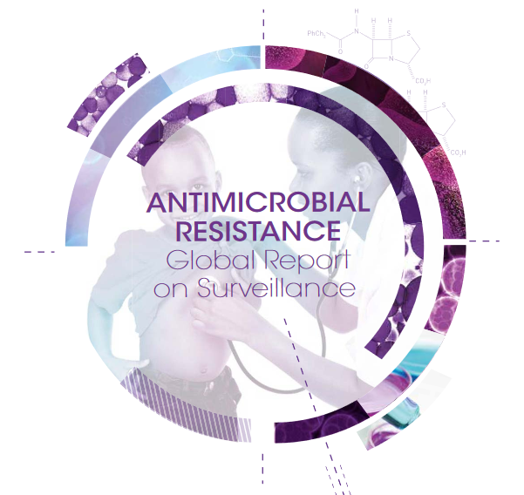
WHO: Global Action Plan Global Report on Surveillance

Slide 3
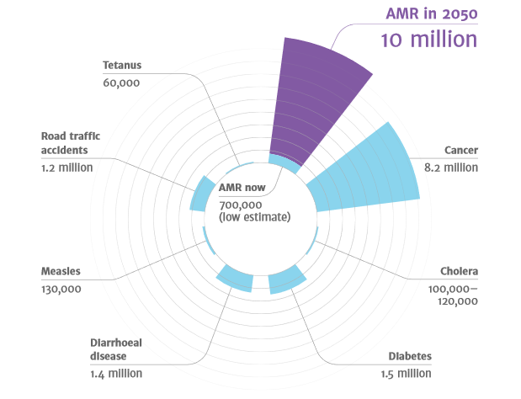
DEATHS ATTRIBUTABLE TO AMR EVERY YEAR:
8th Annual Forum of the EU Strategy for the Baltic Sea Region
The Review on Antimicrobial Resistance, Tackling drug-resistant infections globally:
Final report and recommendations
Sources:
Diabetes: www.whi.int/mediacentre/factsheets/fs312/en/ Cancer: www.whi.int/mediacentre/factsheets/fs297/en/
Cholera: www.whi.int/mediacentre/factsheets/fs107/en/ Diarrhoeal disease: www.sciencedirect.com/science/article/pii/So140673612617280
Measles: www.sciencedirect.com/science/article/pii/So140673612617280 Road traffic accidents: www.whi.int/mediacentre/factsheets/fs358/en/
Tetanus: www.sciencedirect.com/science/article/pii/So140673612617280

Slide 4
WHO Global Report on Surveillance 2014
Key findings and public health implications of AMR are:
Very high rates of resistance have been observed in bacteria that cause common health-care associated and community-acquired infections (e.g. urinary tract infection, pneumonia) in all WHO regions.
There are significant gaps in surveillance, and a lack of standards for methodology, data sharing and coordination.
There is at present no global consensus on methodology and data collection for AMR surveillance.
Community-acquired infections are almost certainly underrepresented among samples, leading to gaps in coverage of important patient groups.
Source: http://apps.who.int/iris/bitstream/10665/112642/1/9789241564748_eng.pdf

Slide 5
The Review on Antimicrobial Resistance (amr-review.org) 10 Recommendations
8th Annual Forum of the EU Strategy for the Baltic Sea Region
A massive global public awareness campaign
Improve hygiene and prevent the spread of infection
Reduce unnecessary use of antimicrobials in agriculture and their dissemination into the environment
Improve global surveillance of drug resistance in humans and animals
Promote new, rapid diagnostics to cut unnecessary use of antibiotics
Promote the development and use of vaccines and alternatives
Improve the numbers, pay and recognition of people working in infectious disease
Establish a Global Innovation Fund for early-stage and non-commercial research
Better incentives to promote investment for new drugs and improving existing ones
Build a global coalition for real action – via the G20 and the UN

Slide 6
IT IS VITAL THAT WE IMPROVE THE GLOBAL SURVEILLANCE OF DRUG-RESISTANT INFECTIONS
“If we cannot measure the development and spread of drug resistance, we cannot manage it.”
“Even in some of the world’s most developed health systems, AMR surveillance data is often patchy and retrospective – virtually none is ‘real time’.
Without effective monitoring, we will lack early warning of emerging patterns of drug resistance, and lack the insights needed to guide and evaluate our response.”[1]
[1] The Review on Antimicrobial Resistance, Tackling drug-resistant infections globally:
Final report and recommendations
Licensed under CC BY 4.0

Slide 7
HOW SURVEILLANCE CAN IMPROVE HEALTH OUTCOMES
Licensed under CC BY 4.0

Slide 8
Disease Surveillance and Information Systems
“Effective surveillance is critical to containing infectious disease outbreaks. Disease surveillance and health information systems should be developed with the long-term vision of creating nationwide, interoperable, and interconnected platforms that are capable of collecting, aggregating, and analyzing information at every level of the health system (community, district, other subnational, and national levels). “ [GHRF, 2016]
GHRF Commission (Commission on a Global Health Risk Framework for the Future).
The neglected dimension of global security: A framework to counter infectious disease crises, 2016

Slide 9
Disease Surveillance and Information Systems
“Such systems should be able to support both indicator-based (syndromic) surveillance and event-based surveillance. Increased access to new information technology has increased surveillance capacity even in countries with limited resources and should be fully exploited. Electronic surveillance tools should be implemented and standardized across the country to transmit information to a central hub that can be accessed in real-time by surveillance staff at every level.” [GHRF, 2016]
GHRF Commission (Commission on a Global Health Risk Framework for the Future).
The neglected dimension of global security: A framework to counter infectious disease crises, 2016

Slide 10
Examples for Health IT Systems and exisiting standards in the domain of AMR
8th Annual Forum of the EU Strategy for the Baltic Sea Region
Germany KISS - Krankenhaus Infektions Surveillance System; ARS - Antibiotika-Resistenz-Surveillance
Austria MONI - Monitoring of Nosocomial Infections
Australia Multiprac®Integrated Infection Prevention and Management System
US NHSN CDA Submission Support Portal (CSSP); CDC Antimicrobial Use and Resistance (AUR) Module
Denmark TREAT - Antibiotic Stewardship and Clinical Decision Support
Sweden The Anti-Infection Tool
Europe ECDC protocols and TESSy

Slide 11
What is lacking?
Structured data
Clinical coverage of data
Clinical incentives (easiness, no double documentation) and means to fulfil the objectives (structured documentation) to reach the targets (supported healthcare of the individual patient without unnecessary work)
Shared and agreed set of common clinical data to use in EHR systems and follow-up systems, CDSSs, surveillance systems, research etc.
Close collaboration between IT experts and clinicians on a European/global level (poles apart so far)

Slide 12
Conclusion
Current data about antimicrobial resistant is often patchy and retrospective. There is no real time data available.
What is lacking is the standardisation of “the last mile” i.e. the data in the clinic
Better surveillance delivers benefits at all levels: local, national and global.
There are already standards available in some countries (e.g. US, Australia, Sweden) that might serve as a starting point.
Automatic electronic surveillance can reduce the workload for hygiene management staff and improve quality of the data.

Slide 13
Real-time data for AMR – a dream or a reality in the near future?

Slide 14
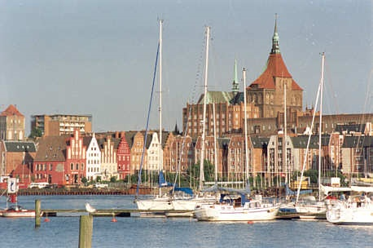
Thank you for your attention !!
Contact:
Dr. Gudrun Mernitz
gm@bcv.org
+49 3834 515 304
Thomas Karopka
tk@bcv.org
+49 3834 515 303
www.bcv.org
BioCon Valley® GmbH Walther-Rathenau-Str. 49a Friedrich-Barnewitz-Str. 8
D-17489 Greifswald D-18119 Rostock Tel.:+49 3834 515-30 Tel.:+49 381 5196-4953 Fax:+49 3834 515-102 Fax:+49 381 5196-495

